Slide 1


Chess Engin With Ai Opponent Course Name: OOPS with C++ Course Code: E1UA203C Group Members 1. Ishan Ahmed – 24SCSE11430066 2. Girish Kumar Maurya – 24SCSE1430219

Slide 2
Introduction
We developed a desktop-based Chess Game using Qt and C++. The application includes:
- Interactive graphical interface
- Basic AI opponent
- Menu options for new game and quit

Slide 3
Feasibility of Project
- Feasible using open-source tools (Qt, C++)
- Moderate learning curve for C++ GUI programming
- Planned in phases: Design, Development, Testing

Slide 4
Project Implementation Plan
1. Requirement Analysis
2. Technology Stack Selection
3. Design Phase
4. Development Phase
5. Testing & Debugging
6. Final Integration & Packaging

Slide 5
Project Domain Introduction
Our project falls under the domain of Game Development and Artificial Intelligence.
It emphasizes object-oriented design, human-computer interaction, and AI-based decision making in the context of classic board games.

Slide 6
Project Outcomes
Interactive Chess GUI Developed a functional and visually clean 8×8 chessboard using Qt with algebraic notation on each square. Basic AI Opponent Implemented an AI that plays legal and semi-intelligent moves using the Minimax algorithm.

Slide 7
Project Outcomes
Functional Menu System Added options like New Game, Resign, and Quit for better user control and application flow. Player Interaction Enabled smooth user interaction through click-to-move controls and legal move validation. Object-Oriented Design Designed the system using classes for board, pieces, and AI, showcasing OOPS principles.

Slide 8
Objective 1: Design and Build a Chess GUI
- Implemented a traditional 8x8 board with algebraic notation
- Enabled player move interaction via click-to-move
- Developed a clean and responsive layout similar to Chess.com

Slide 9
Objective 2: Implement AI for Opponent Moves
- Developed basic AI logic using min-max algorithm
- Evaluates board states and generates legal moves
- Adjustable difficulty for different player levels

Slide 10
Objective 3: Integrate Menu and Game Control Options
- Added functional menu: New Game, Quit, About
- Option to restart or exit game cleanly
- Improved user control and experience

Slide 11
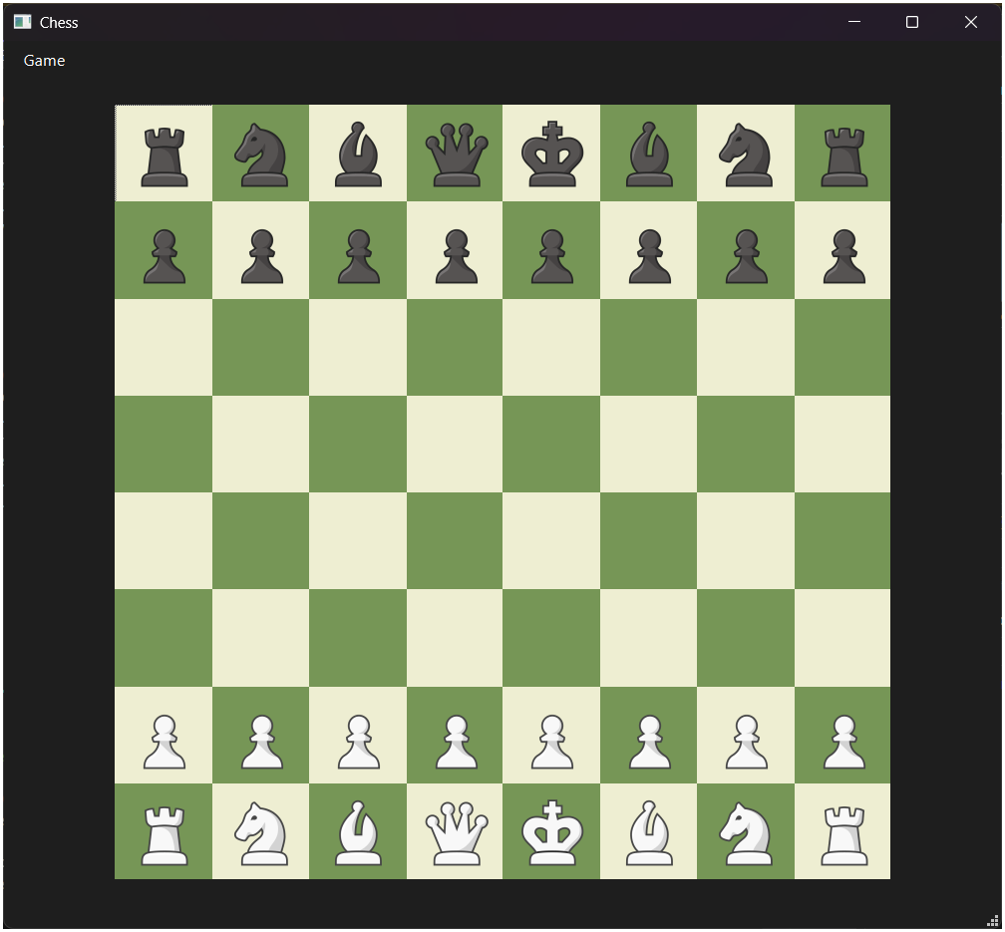
Screenshots

Slide 12
Application Area of Work
- Game development and design
- Educational use in learning chess
- Experimentation with AI logic and algorithms

Slide 13

Thanks and Regards

